Slide 1

ISLAMIC BANKING WINDOW
MCF “IMON”
    Head office
    735700 Republic of Tajikistan
    Sogd Province, Khujand city, microdistrict 19, 55
    Contact
    Phone +992 48 701 4444
    Email info@ibw.tj
    Web www.ibw.tj

Slide 2
ABOUT US
Obtaining a License of the National Bank of Tajikistan - February 3, 2020.
Commencement of operations - April 13, 2020.
The first financing product - MURABAHA.
Home MURABAHA - January 2021.
Ijara muntahiya bitamlik - December 2021.
Salam - December 2022.
Qard Hasan – June 2024.

Slide 3
ABOUT US
CAPITAL ATTRACTION
The first foreign capital was accepted for Islamic financing. On July 7, 2023, the Wakala Agreement on the Islamic financing line was signed between IBW and the PIU of the Ministry of Finance of Tajikistan.
OPENING A SERVICE CENTERS
The first service center was opened in Bokhtar city on August 11, 2023. Through the Service Center, the activity of IBW is expanding in Khatlon region.
The second service center was opened on September 16, 2024 in the capital of Tajikistan, Dushanbe city.

Slide 4

Our mission
To facilitate the establishment and development of Islamic financing in the country as an alternative financial service system, as well as the implementation of ethical and justice-based principles in transactions, as prescribed by Islam.

Slide 5
OUR OBJECTIVES
Compliance with the principles of transparency, justice and trust.
Increasing the level of Islamic financial knowledge of society.
Expanding the range of products.
Attracting domestic and foreign investment.

Slide 6

MANAGEMENT BODY
BOARD OF TRUSTEES
COMMITTEE on ISLAMIC FINANCE SERVICES
CHAIRMAN
ISLAMIC BANKING WINDOW
SERVICE CENTER in BOKHTAR city
SERVICE CENTER in DUSHANBE city

Slide 7

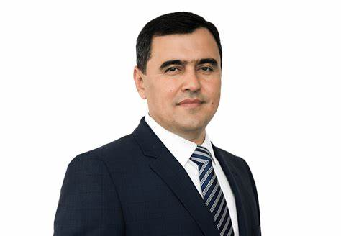
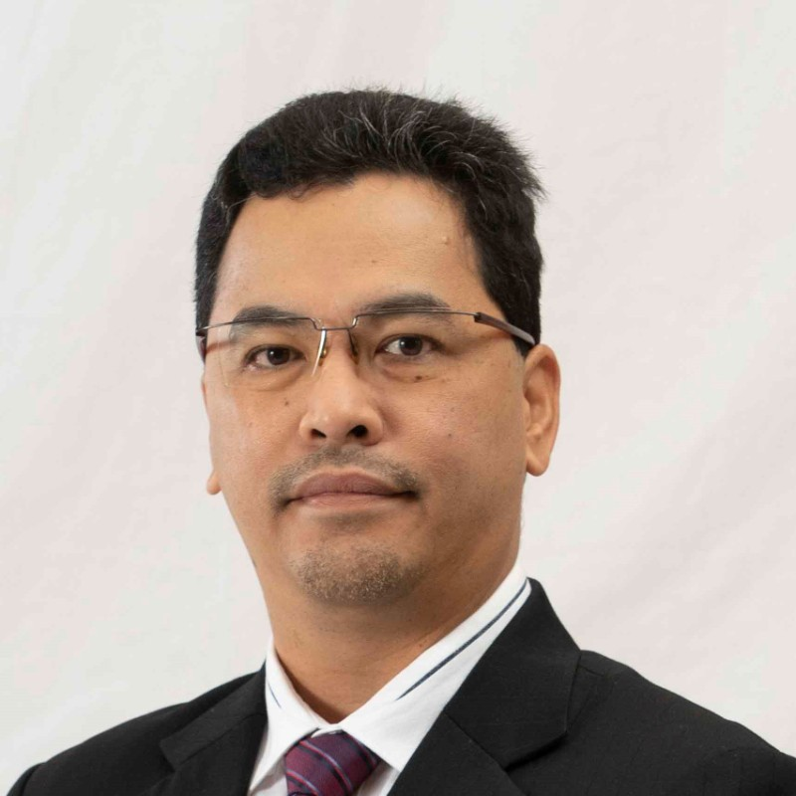
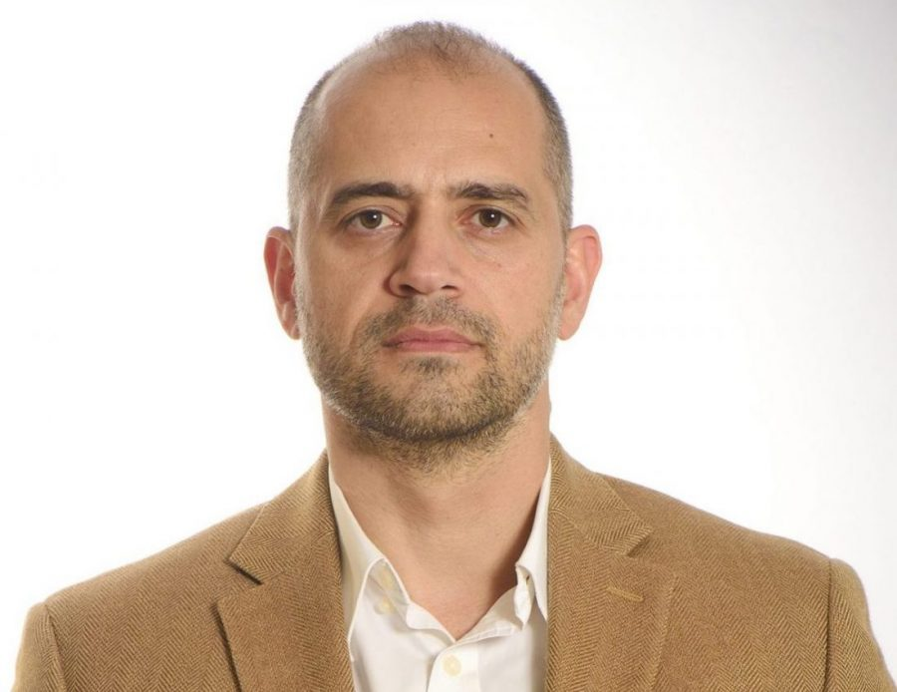
COMMITTEE on ISLAMIC FINANCE SERVICES
(Shariah Board)
Mahmadruzi Shoev
Chairman of the Committee
Dr. Ashraf BIN MD Hashim
Member of the Committee
Dr. Abozayd Abdulazim
Member of the Committee

Slide 8






Our Development Partners

Slide 9

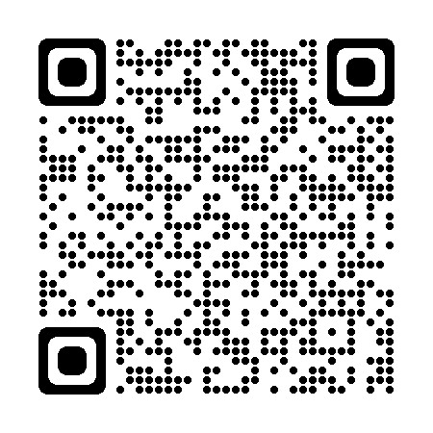


Islamic Finance to enhance your well-being
CONTACT US
https://ibw.tj
info@ibw.tj
+992 92 707 1559
+992 48 701 4444

